Slide 1

Artificial Intelligence-Enabled Surveillance of Knee Osteoarthritis Through Gait Analysis Project Category: Research
PROJECT REVIEW - 2
Guide: | Student Name & Registration Number:
Dr. S. Karthick | Mr. Karthik B – RA2112701010014
 | Mr. Udhaya M – RA2112701010021

Slide 2
OBJECTIVE
Develop an AI-Based Gait Analysis Model
Implement computer vision and deep learning algorithms to extract movement features from video data.
Detect Post-Surgical Abnormalities and Deviations
Identify gait deviations, improper joint mobility, weight distribution issues, and other complications.
Automate the Post-Operative Assessment Process
Generate reports with key recovery metrics

Slide 3
DATASET OVERVIEW
The KOA-NM dataset is designed for Knee Osteoarthritis (KOA) detection using gait analysis.
It contains video recordings of individuals categorized based on KOA severity levels.
A set of 6 red-colored passive reflective markers has been attached to the subject’s body joints.
The dataset is collected using a single NIKON DSLR 5300 camera placed 8m away from the walking mat.
Videos are in .MOV format
KOA-NM Dataset consists of gait videos classified into four categories:
NM (Normal Movement)
KOA_EL (Easy KOA)
KOA_MD (Moderate KOA)
KOA_SV (Severe KOA)

Slide 4
PRE PROCESSING
Video Format Conversion
Converted .MOV files to .MP4 for compatibility.
Frame Extraction
Extracted frames from videos at a uniform FPS (Frames Per Second).
Noise Reduction & Enhancement
Applied Gaussian Blur and contrast enhancement for better feature extraction.
Pose Estimation
Used Mediapipe to extract joint movement key-points.
Key-Points Detection
Identify the maker placed in joints of subject and store.
Data Augmentation
Introduced rotation, flipping, and brightness variations to improve model generalization.

Slide 5
PRE PROCESSING
Challenges:
Unreadable .MOV files
Inconsistent FPS
Blurred frames
Missing joint key-points
Solutions:
Converted to .MP4
Standardized to fixed FPS
Applied sharpening & noise reduction
Improved pose estimation accuracy

Slide 6
FEATURE EXTRACTION
Input Data:
MOV format videos of patients walking from left to right (side view) across an 8-meter distance in front of a fixed camera.
Pose Estimation with MediaPipe:
Extracts key body landmarks per frame:(x, y, z, visibility) for each joint.
Emphasis on lower-body joints (hip, knee, ankle) to assess post-knee replacement recovery.

Slide 7
FEATURE EXTRACTION
Preprocessing Steps:
Convert video to frames (e.g., 30 fps).Normalize and resize frames for uniformity.
Side view improves joint movement visibility during gait cycle.
Data Structuring:
Landmark data arranged as time series sequences:
Format: (frames, joints, features)
Example: 300 frames × 33 joints × 4 features
Padding/truncation applied for fixed sequence length.

Slide 8
Model Architecture
Architecture
Feature Extraction (CNNs) – Extracts spatial features from each frame.
LSTM Layer – Captures temporal dependencies in gait patterns.
Fully Connected Layer – Classifies severity levels of KOA.
LSTM for KOA Detection
Handles sequential gait data effectively.
Remembers long-term dependencies in walking patterns.
Outperforms traditional CNNs in analysing movement over time.
Improves KOA severity classification by learning time-series variations in gait

Slide 9
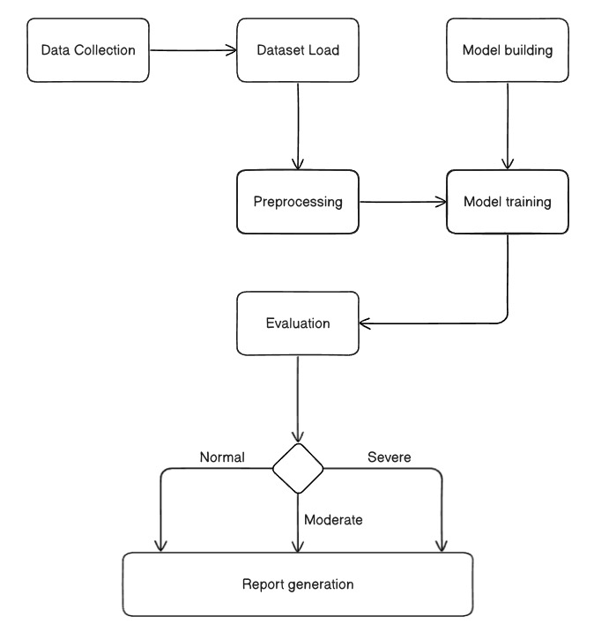
Architecture Diagram
Classification

